Slide 1
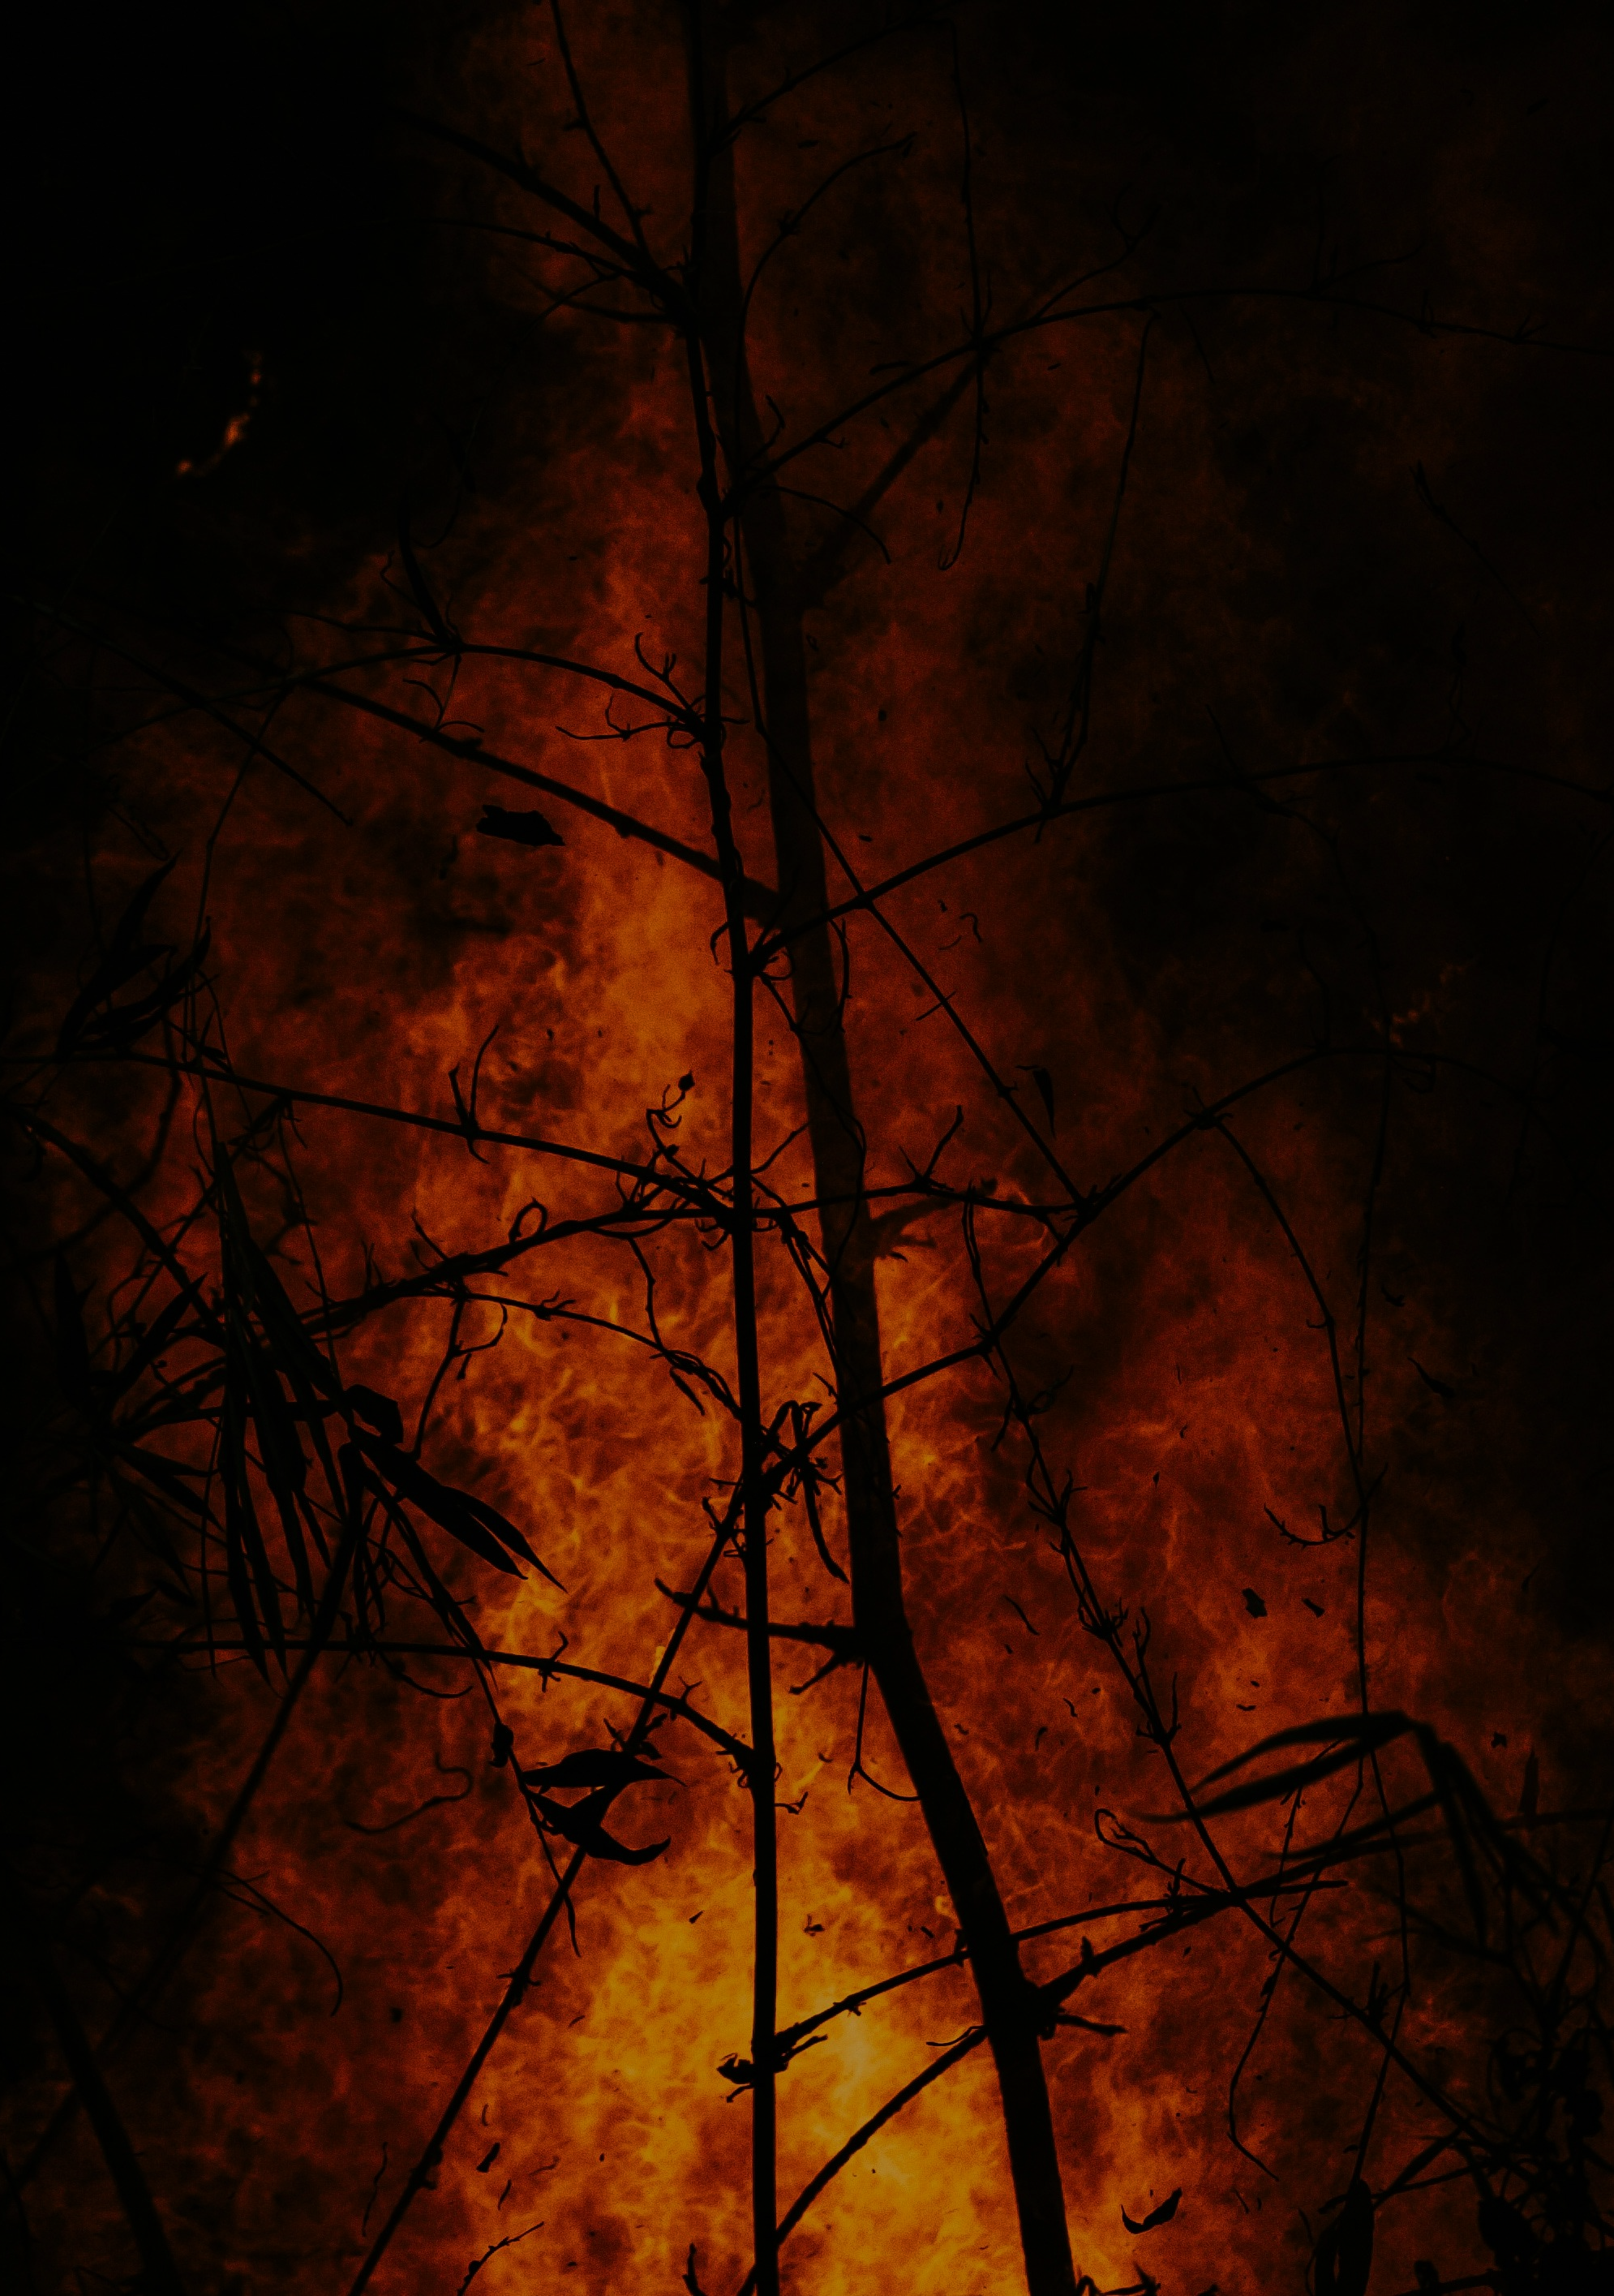



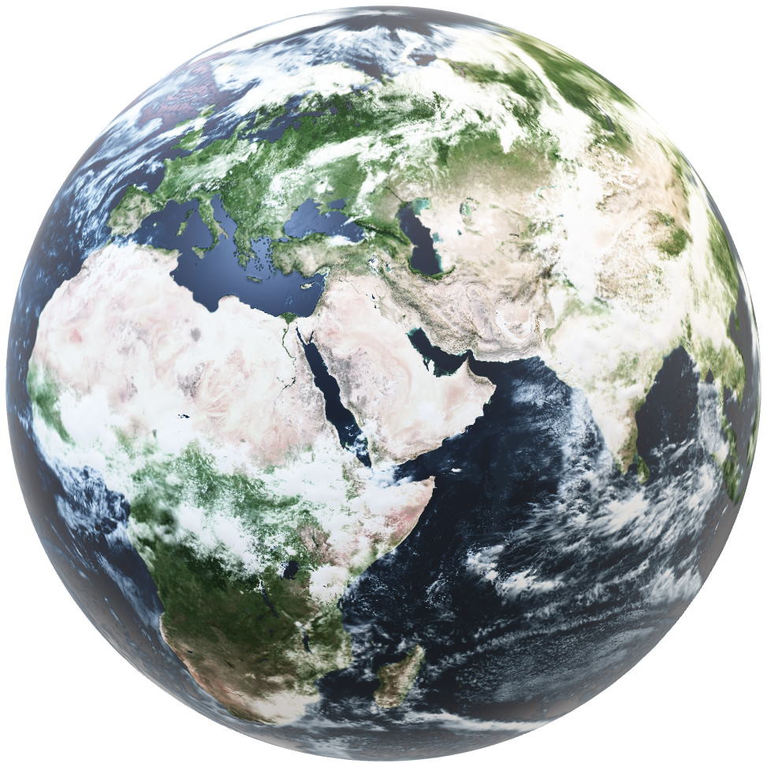
GREEN SPARK
A BURNING PRIORITY
We predict Wildfires are going to double from 3.4 million hectares today to 6.8 million by 2040

Slide 2
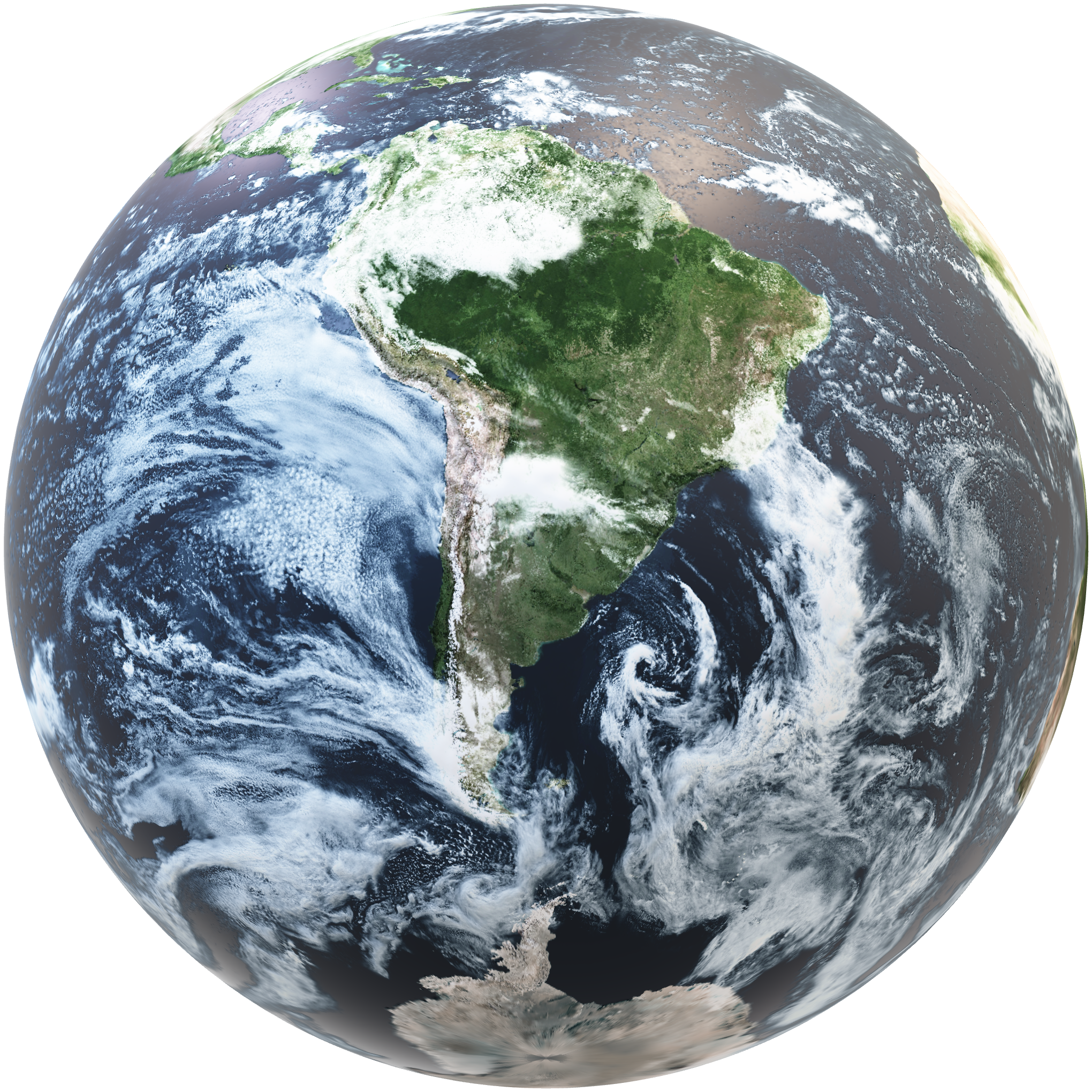
GREEN SPARK
A BURNING PRIORITY
WILDFIRE LAND DEGRADATION
‘Temperature in Brazil could increase by as much as 2.2°C by 2050’
-G20 Climate Change atlas

Slide 3

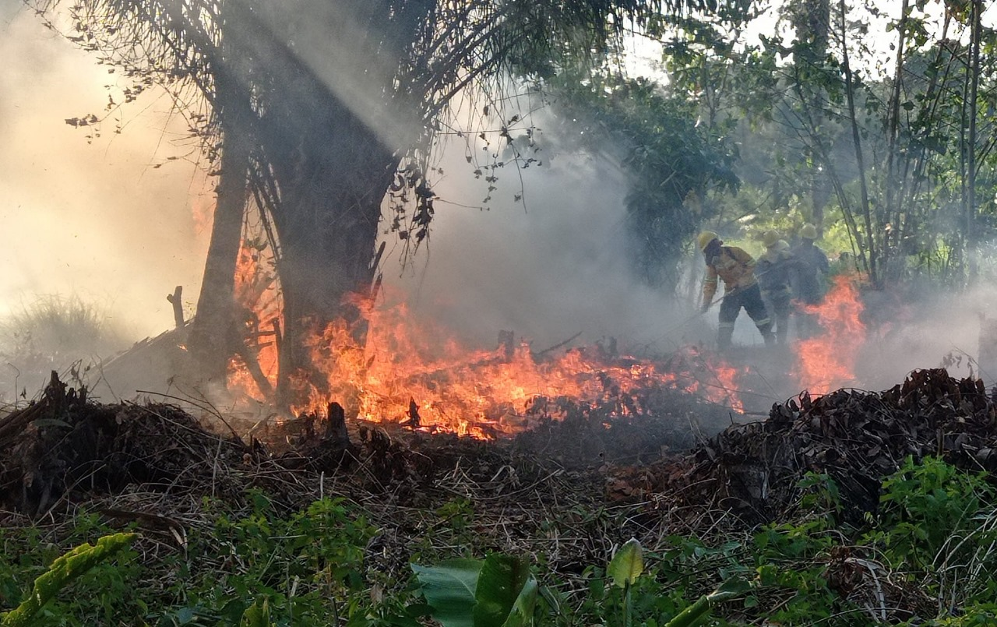
Wildfires are going to double from 3.4 million hectares today to 6.8 million by 2040

Slide 4
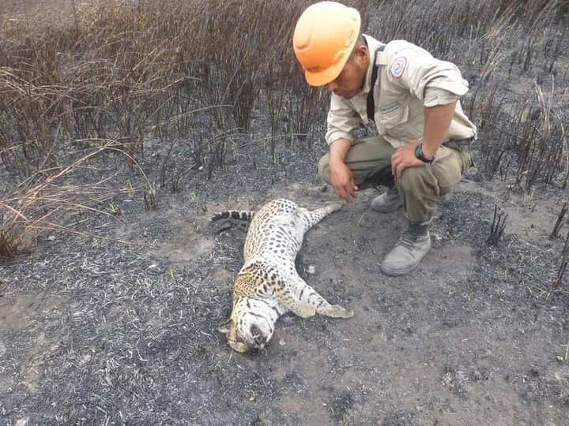
High Impact Fires occurred predominantly in the Amazon, Cerrado, and Pantanal biomes

Slide 5












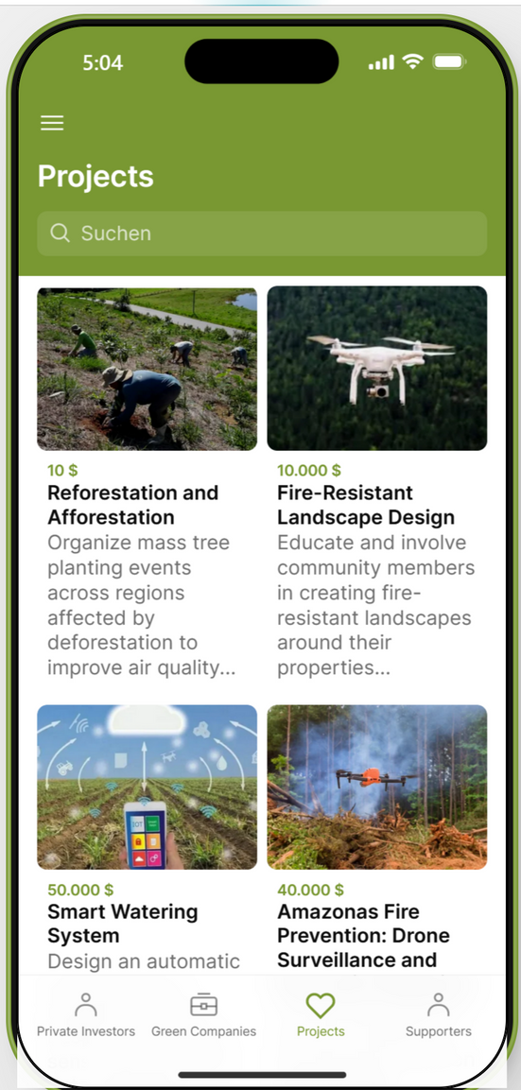
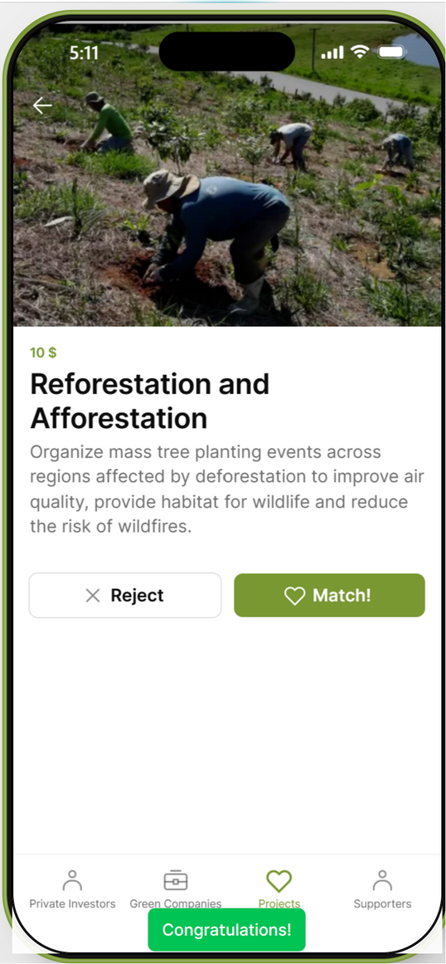
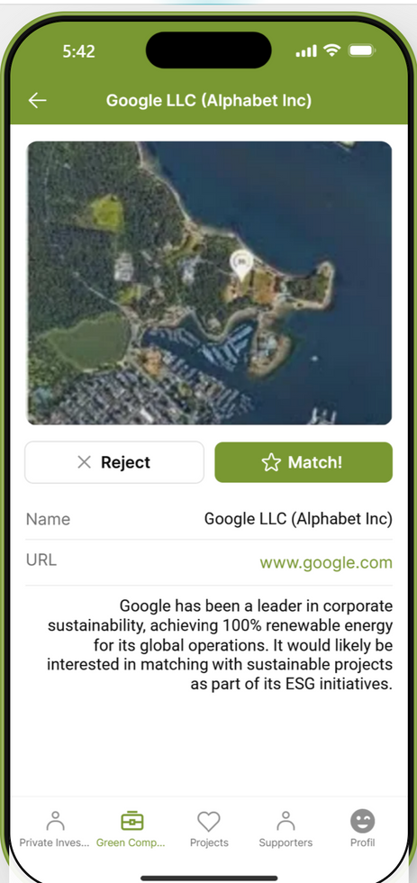

Solution
Entrepreneurs
Matching App
Investors
Government
Create your Profie
Overview of the projects
Match with a Project!

Slide 6
The Matching Platform: Investors portal
Create your Profie
Overview of the projects
Match with a Project!

Slide 7
The Matching Platform: Project owner’s portal

Slide 8
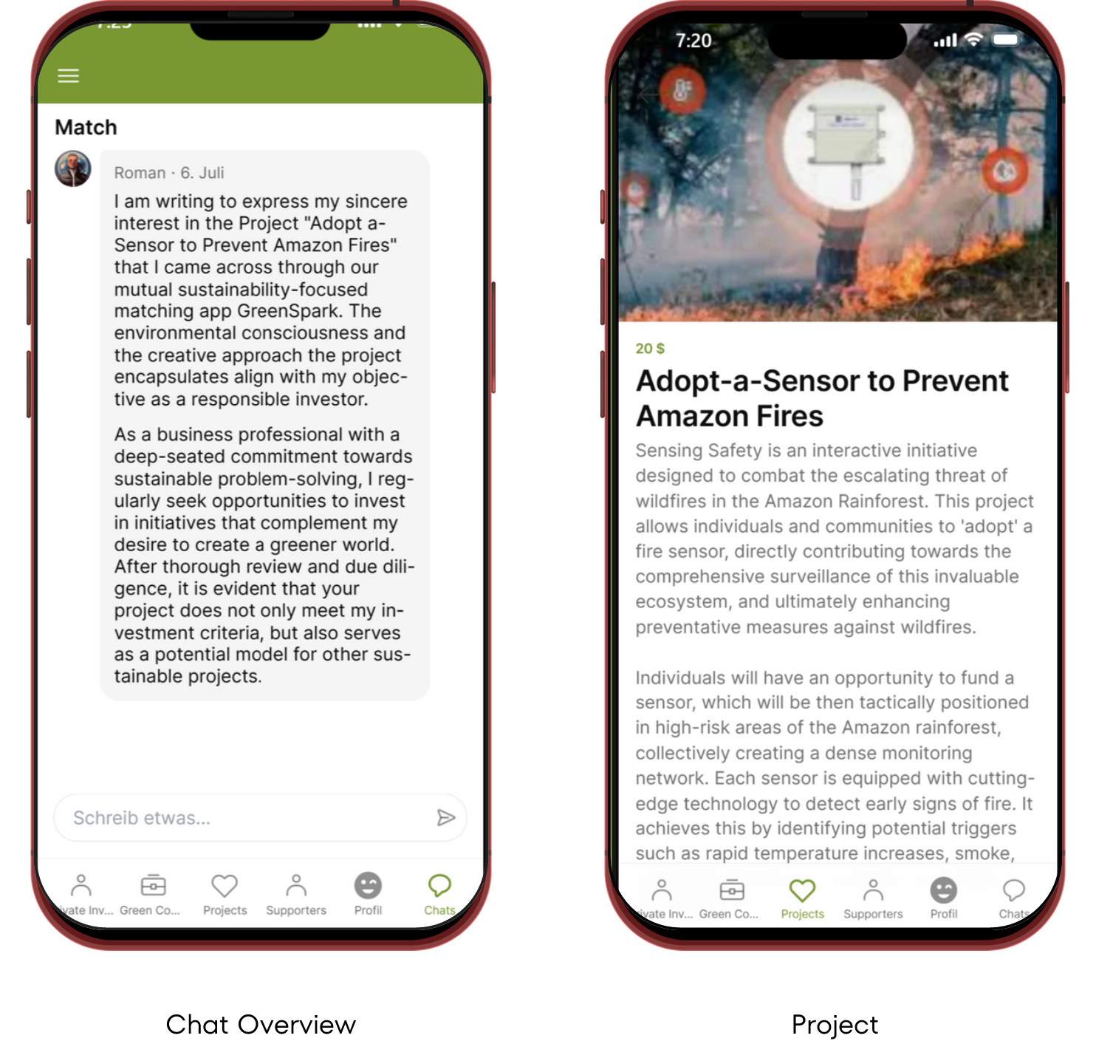
Adopt a Sensor’s Project
Creator

Slide 9

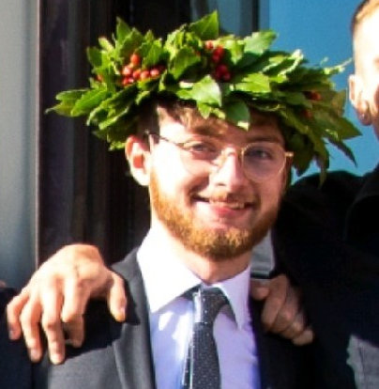


Team
Visionary
Creator
Task 3 Questions
Paola Andrea Herrera Trigo
Pietro Caforio
Francesco Caserta
Oscar Aragon Celis
Thanks for your attention!

